Slide 1


Plotting Data in MATLAB

Slide 2

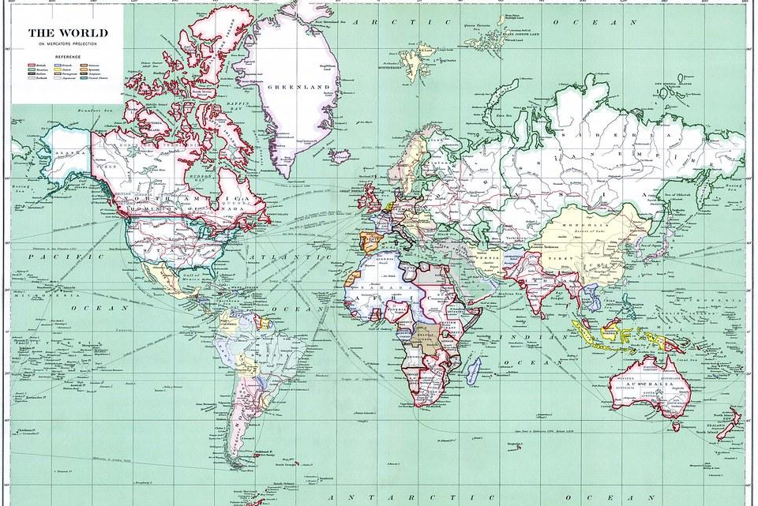
Plotting Data in MATLAB
Maps
You may have heard there is no way to truly correct way to represent our Earth on a flat image. It is impossible to unwrap the spherical dimensions of the globe to perfectly portray the layout and shapes of our globe on a 2D surface.
This has posed a fundamental challenge from the inception of their tradition. Mapmakers have had to decide what information to preserve and what information to distort to communicate the important information their maps need to convey. As a result, there are many projections or techniques of flattening the globe that have proven useful.

Slide 3
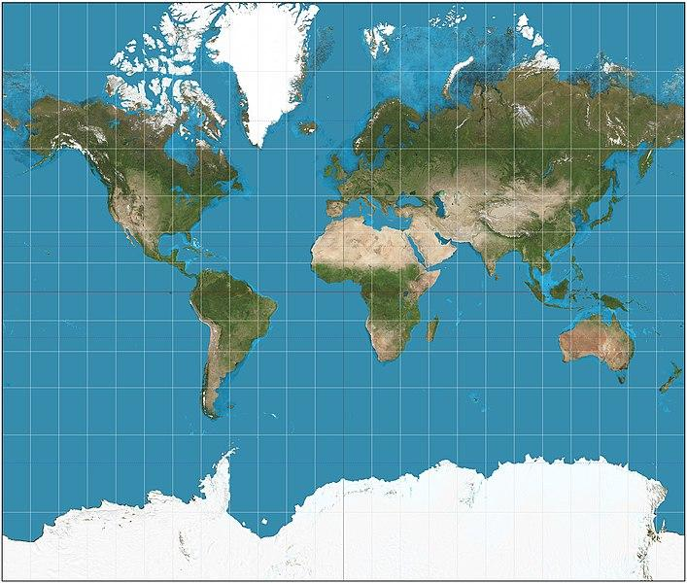
Plotting Data in MATLAB
Maps
The Mercator projection is a popular map style for use in navigation. It represents lines of straight travel on a constant course, which proved useful for planning trips across the sea. To convey course properly, the size of landmasses is greatly distorted. This is why Greenland is often mistaken for being over 500 times larger than it really is.
Mercator Projection

Slide 4

Plotting Data in MATLAB
Maps
Even the positioning of landmasses is a result of decisions made by the mapmakers. Europe might not have been positioned in the top-center if the mapmakers were raised somewhere else. There is no up or down or left or right in space, and these decisions do not represent objective truth.
When we communicate data, we are -in a way- mapmakers, charting informational territory and placing emphasis on aspects of data we are trying to emphasize. This comes with a lot of decision-making and utilization of different techniques
Get into groups and search the web for different types of maps.
Consider the following:
What do each of them emphasize or distort?
Discuss your findings with your classmates!

Slide 5
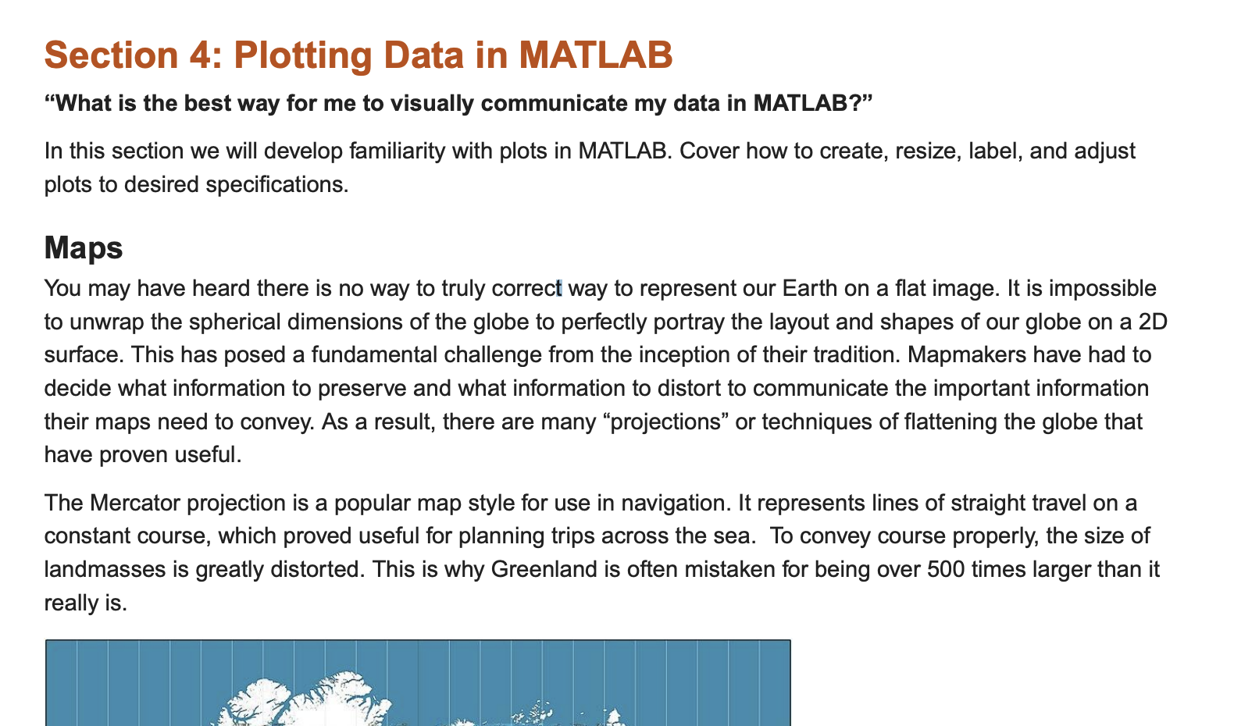
Plotting Data Activity
Please copy over the files for Section 04 from the MATLAB Drive
The MATLAB files for this section can be found at this link.
Notes:
The URL on this slide is for the student version of the files, please see the teacher guide for the teacher version of the files You can also find the teacher and student links on the master document with all the youtube video and matlab drive links for every section on it

Slide 6
Plotting Data in MATLAB
Importing your Data
To start, you can clear your Command Window and Workspace to keep it organized
The "clc" function clears the Command Window, and the "clear" function clears the Workspace

Slide 7
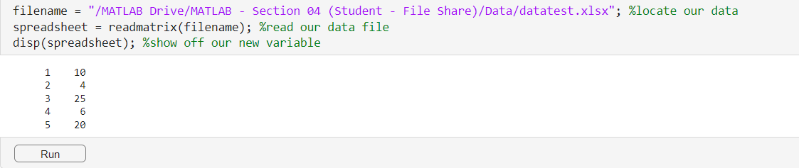
Plotting Data in MATLAB
Importing your Data
In order to plot our data, first we have to be able to access it from the excel file
We want to assign the file's location to a variable so that you can import your data. Right click the file in your Files tab located on the left hand side and select Copy Path. Paste that as your filename.
The following code gives an example of this as well as how to read and the display the data file.

Slide 8
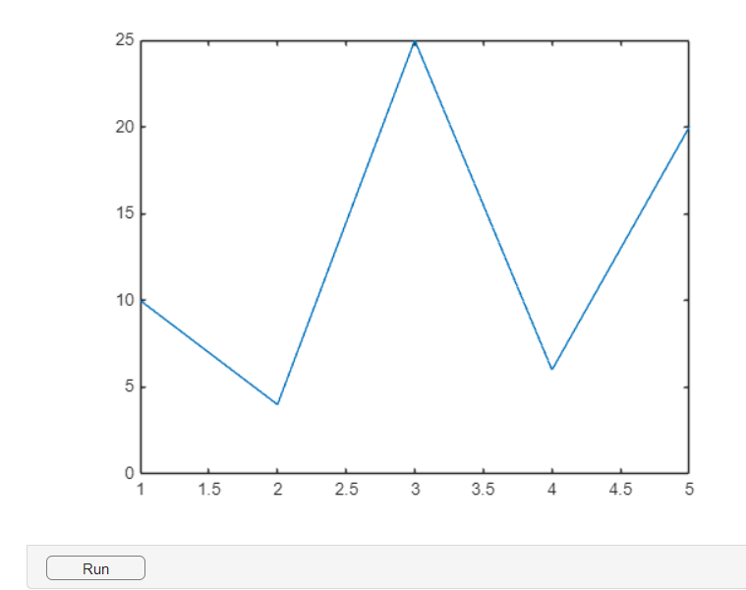
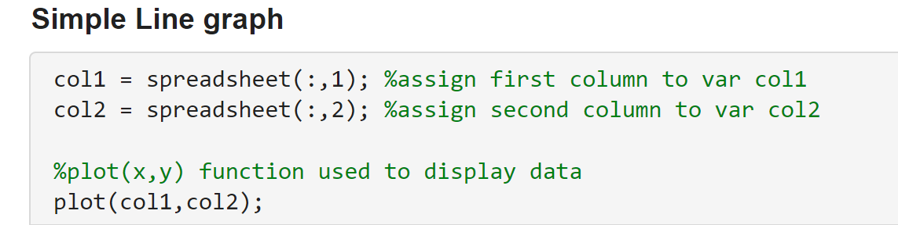
Plotting Data in MATLAb
Plotting Functions
Here's how to plot a simple line graph!
Take data in the form of columns from your spreadsheet and assign them to two different variables.
Using the "plot()" function you can create a simple line graph! For this function, the inputs are listed as your x data followed by your y data.

Slide 9
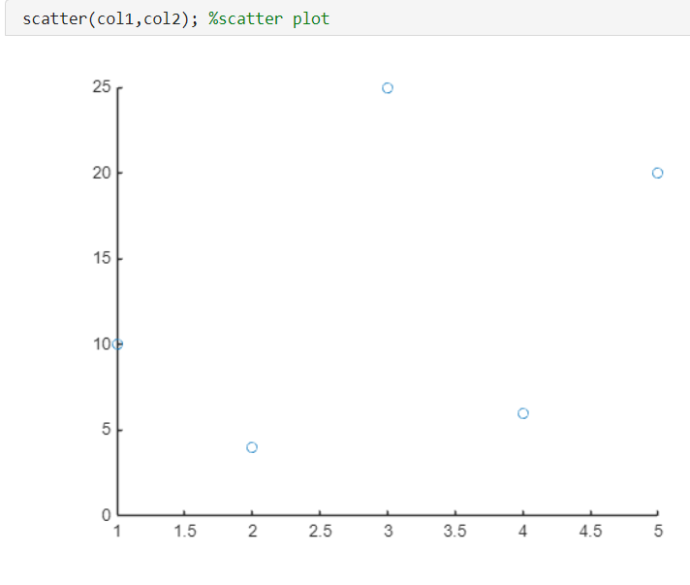
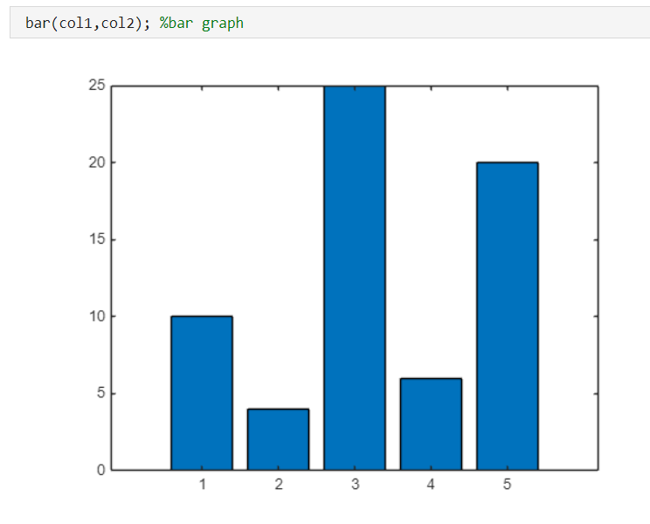
Plotting Data in MATLAB
Plotting Functions
Here are two more types of graphs you can create. They both follow the same input format as plot.

Slide 10

Plotting Data in MATLAB
Lil Pump: Importing Data
Now let's take a look at how we can use plots in action. A few years ago, Lil Pump was the talk of the town. The question is: what is he up to now? Let's look into the current status of the once world-famous Gucci Gang artist.
The following code introduces a new function, "readcell()". This function takes each element from a text file and turns them into a cell. Use it to import data about Lil Pump from excel.

Slide 11

Plotting Data in MATLAB
Lil Pump: Importing Data
Take a look at the data. Which columns are most important for tracking popularity over time?
Chart_week and rank_score_sum are the best columns to track popularity over time. Rank_score_sum is an aggregate data point ranking an artist's popularity with a score representing streams, downloads, radio time, etc.
Now create two arrays named 'rank' and 'date' containing the data of columns 5 and 3, respectively. (Hint: make sure to exclude the titles in the first row)

Slide 12
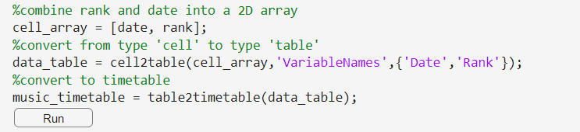
Plotting Data in MATLAB
Lil Pump: Importing Data
Now we need to organize our data so that we can plot! Begin by combining your two columns into a new array.
Use the "cell2table()" function to convert the data type from cell to table. Once you do this you can convert the table type to a timetable using the "table2timetable()" function. A timetable is a type of table that associates a time with each row. This is useful for plotting popularity over time!

Slide 13
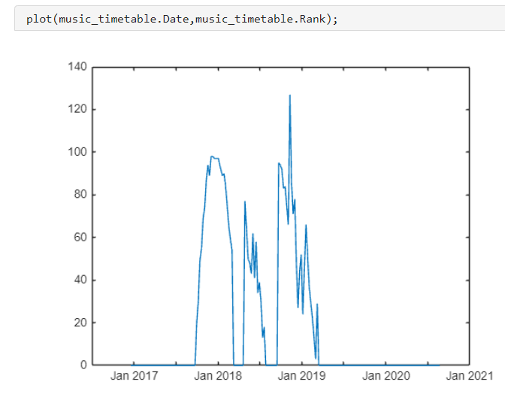
Plotting Data in MATLAB
Lil Pump: Simple Plot
Now that you have a timetable containing Date and Rank information, try plotting the data!
Congrats! You just plotted your first simple plot using real world data!

Slide 14
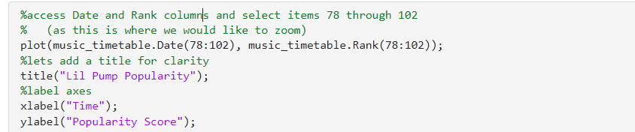
Plotting Data in MATLAB
Lil Pump: Simple Plot
That chart showed us a standardized measurement of Lil Pump's popularity over the course of a few years. Let's zoom in and look at his rank in the charts over his first major peak in popularity.
Access the Date and Rank columns. We want to zoom into items 78 through 102 for both, so select these.

Slide 15
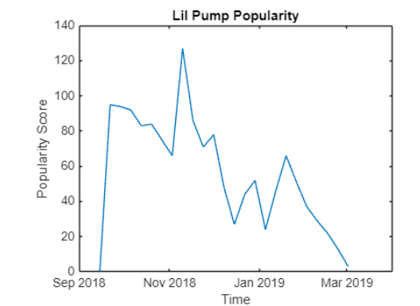
Plotting Data in MATLAB
Lil Pump: Simple Plot
Let's add a title and axis for clarity. We can do this using the "title()", "xlabel()", and "ylabel()" functions. When using these functions, make sure you are writing the inputs in quotations marks, and that you're writing these functions after the "plot()" function.

Slide 16
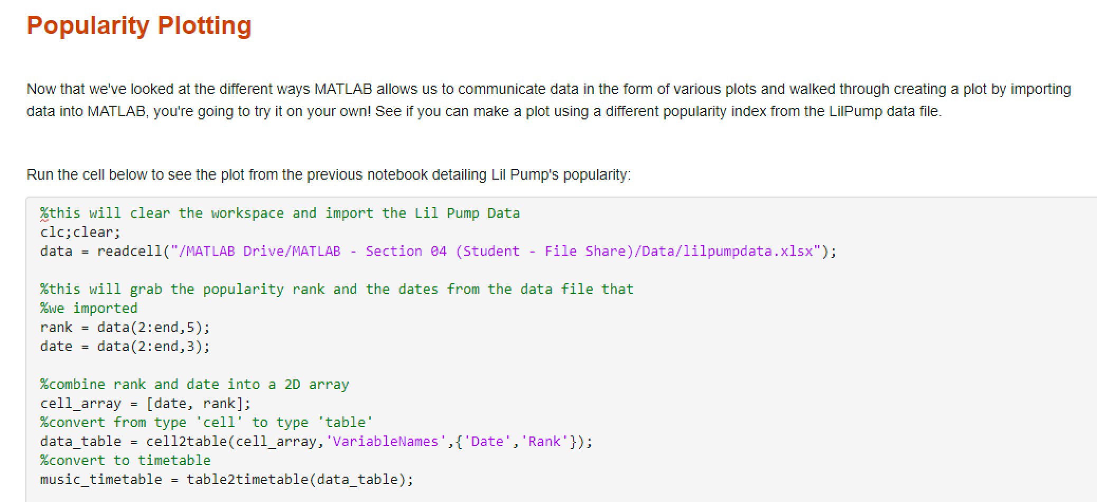

Popularity Plotting
The file for this assignment is also in the MATLAB Drive, as “Part 2”, please open and complete the activity.​
The MATLAB files for this section can be found at this link.
Notes:
The URL on this slide is for the student version of the files, please see the teacher guide for the teacher version of the files You can also find the teacher and student links on the master document with all the youtube video and matlab drive links for every section on it

Slide 17

Popularity Plotting
Lil Pump
Now that we've looked at the different ways MATLAB allows us to communicate data in the form of various plots and walked through creating a plot by importing data into MATLAB, you're going to try it on your own!
Follow the instructions in the notebook and run the cell so you can see the previous plot.

Slide 18
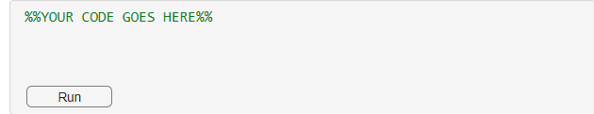
Popularity Plotting
Problem 1
Now see if you can make a plot using a different popularity index from the LilPump data file, how does your chart compare with the original? Another popularity index would be something else that might affect or measure popularity, such as danceability.
Try double clicking the "data" variable in your workspace to look at the different features in each column! Type your code in the space provided.

Slide 19

Drawing Conclusions on Data Plotting
Let's think about the lesson and activity we just did:
In this lesson, we learned about plotting and visualization techniques in MATLAB and practiced creating our own plot. We also learned visualization techniques to present data in an efficient and appropriate manner.
Thinking about this (and the Lil Pump Popularity data we just analyzed) discuss and write down your ideas for the following in groups :
Compare the two plots created using the various popularity indices from the data file linked in the assignment.
What can we infer from these graphs?
Hint: When may Gucci Gang have been released? When was Lil Pump in his peak popularity?

